Slide 1





SmartHealth AI: Predictive Analytics
for Early Disease Detection
Using Lifestyle Data & Machine Learning
Presented By
Subject
Data Analytics
Rakhshaan Shaikh
Shashank Sonawne
SB3-AIDS-33
SB3-AIML-13
Department
Department of Computer Science
Atharva Bavale
Vikalkumar Shinde
SB3-AIDS-23
SB3-AIML-18
2026 Microproject Submission

Slide 2





Introduction
Understanding the foundation of modern predictive health systems
Healthcare Analytics
Importance of Early Detection
The AI Paradigm Shift
The systematic use of data to drive improvements in clinical care, operational efficiency, and patient outcomes.
Transitioning from retrospective reporting ("what happened?") to predictive insights ("what will happen?") for proactive care.
Identifying health risks before symptoms appear significantly reduces complications, treatment costs, and mortality rates.
02

Slide 3









Problem Statement
Critical challenges in modern healthcare diagnostics
The Reality
Rising Lifestyle Diseases
Late Diagnosis
70%
Chronic conditions like diabetes and hypertension are escalating rapidly due to modern sedentary lifestyles and dietary habits.
Current diagnostic methods are often invasive or infrequent, leading to detection only after significant health damage has occurred.
of deaths globally are caused by chronic diseases, many of which are preventable.
Traditional healthcare is reactive. We wait for symptoms to appear before taking action, losing valuable time for intervention.
Fragmented Data
Need for Scalability
Valuable health data is scattered across wearables, paper records, and disparate systems, preventing a holistic view of patient health.
Traditional screening is resource-intensive. There is a critical need for low-cost, AI-driven risk identification tools that can scale.
03

Slide 4






Project Objectives
Strategic goals for the SmartHealth AI initiative
01
02
Predictive Risk Modeling
Early Warning System
Develop a robust machine learning model utilizing lifestyle and clinical variables to accurately assess individual health risks.
Enable proactive detection of high-risk individuals before symptoms manifest, allowing for timely medical intervention.
03
04
Personalized Care
Clinician Decision Support
Generate tailored lifestyle and prevention recommendations based on specific risk factors and patient history.
Provide explainable AI outputs to assist healthcare professionals in making data-driven diagnostic decisions with confidence.
05
Ethical & Private AI
Ensure the highest standards of patient data privacy, model fairness, and ethical considerations in all algorithmic processes.
04

Slide 5










Dataset Description
Comprehensive overview of features and variables
Data Sources
Total Records
Target Variable
Wearables, Patient Surveys, Electronic Health Records
12,500+ Patients (Anonymized)
Disease Risk Level (Low / Medium / High)
Feature Name
Description
Data Type
Demographics
Age, Gender, Ethnicity, Location (Urban/Rural)
Categorical / Numerical
BMI Index
Body Mass Index calculated from Height and Weight
Numerical (Float)
Physical Activity
Average daily steps, weekly exercise minutes, intensity levels
Numerical (Int)
Sleep Patterns
Average hours of sleep per night, sleep quality score
Numerical (Float)
Blood Pressure
Systolic and Diastolic readings (mmHg)
Numerical (Int)
Glucose Level
Fasting blood sugar levels (mg/dL)
Numerical (Int)
Family History
Presence of hereditary diseases in immediate family
Boolean (Yes/No)
Diet & Nutrition
Caloric intake, fruit/veg consumption frequency
Categorical (Ordinal)
05
Stress Levels
Self-reported stress score (1-10 scale) or cortisol indicators
Numerical (Int)
Risk Prediction
Likelihood of disease onset within 5 years
Target Variable

Slide 6

















Methodology
5-Stage End-to-End Machine Learning Pipeline
1
2
3
4
5
Data Ingestion
Preprocessing
Feature Engineering
Model Training
Deployment
Data Collection
Data Cleaning
Feature Selection
Algorithm Selection
Performance Eval
Source Validation
Missing Imputation
Dimensionality Red.
Hyperparam Tuning
Model Interpretation
Raw Data Storage
Normalization
Transformation
Cross-Validation
API Packaging
06

Slide 7



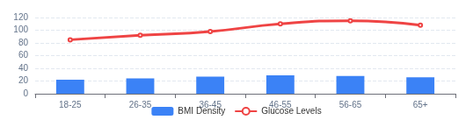
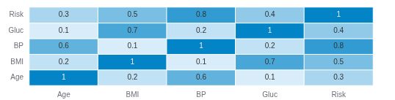


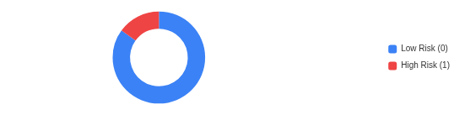
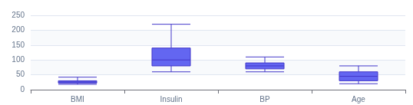
Exploratory Data Analysis
Unveiling data patterns, quality issues, and feature relationships
Feature Distribution
Correlation Heatmap
Insight: BMI and Glucose levels show a right-skewed distribution, indicating a segment of the population with significantly higher risk factors.
Insight: Strong positive correlation (0.72) observed between Age and Blood Pressure. Glucose levels correlate moderately with the target variable.
Target Variable Balance
Outlier Detection
Critical: The dataset is imbalanced with only 15% positive cases (Disease Detected), necessitating resampling techniques like SMOTE.
Action: Significant outliers detected in Insulin and BMI features. Robust scaling will be applied to minimize model sensitivity.
07

Slide 8








Models Used
Comparative analysis of machine learning algorithms
Logistic Regression
Random Forest
XGBoost / LightGBM
Baseline Model
Ensemble Method
High Performance
Serves as a robust baseline for binary classification problems.
Captures non-linear relationships and complex interactions between lifestyle variables.
State-of-the-art accuracy on structured tabular data by reducing bias and variance.
Highly interpretable coefficients allow for direct understanding of feature impact.
Optimized for speed and performance with handling of sparse data.
Provides feature importance scores to identify critical risk factors.
Computationally efficient and less prone to overfitting on small datasets.
Advanced regularization parameters prevent overfitting in complex models.
Handles outliers and missing data effectively through bagging techniques.
Linear
Interpretable
Probabilistic
Non-linear
Robust
Feature Importance
Gradient Boosting
High Accuracy
Scalable
08

Slide 9








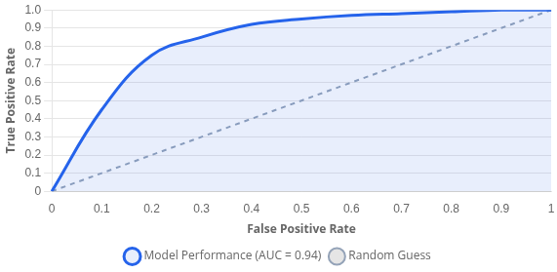
Results & Performance
Model evaluation metrics and validation outcomes
89.2%
87.5%
91.0%
89.2%
0.94
Accuracy
Precision
Recall
F1 Score
ROC-AUC
Confusion Matrix
ROC Curve Analysis
Predicted Class
Actual Class
Positive
Negative
Positive
400
50
Negative
True Positive
False Negative
58
492
False Positive
True Negative
09

Slide 10









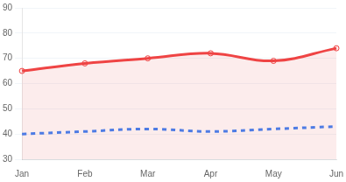
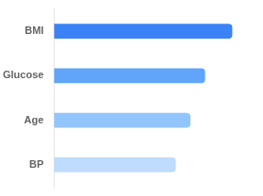



Analytics Dashboard
Real-time Interface: Patient Risk Scores & Predictive Insights
Total Cohort
High Risk Identified
Avg Risk Score
Actionable Alerts
1,248
142
42.5
8
12% vs last month
11.3% of total
Stable
Requires review
Patient #492 Risk
Cohort Risk Trend (6 Months)
Diabetic
All
Top Risk Drivers
87
CRITICAL
Recent Alerts & Recommendations
View All
Patient #492: BP Spike Detected
Notify
Patient #881: Adherence Risk
Review
Systolic > 160mmHg | 10 mins ago
Refill overdue by 5 days
10

Slide 11







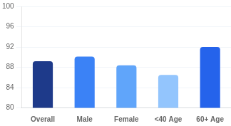


Interpretation & Clinical Insights
Translating Model Outputs into Medical Action
Clinical Plausibility & Feature Effects
Operational Thresholds
Analysis of how top predictors influence the risk score compared to clinical baselines.
Decision boundary adjusted to favor Recall (minimize missed cases).
BMI > 30
+2.5x Risk
Strongest predictor; consistent with metabolic syndrome pathology.
Safe (0.0)
High Risk (1.0)
Protective factor; moderate exercise >150min/week significantly lowers risk.
0.40
High Activity
-40% Risk
98%
12%
High
Family History
+1.8x Risk
Genetic predisposition adds baseline risk regardless of lifestyle.
Sensitivity
False Pos. Rate
Screening Utility
Fairness & Subgroup Performance
Limitations & Confounders
Age 60+
Highest accuracy (92%) due to distinct symptom presentation.
Self-Reported Data Bias
Slightly lower recall (88%) compared to males; warrants specific feature engineering.
Female
Temporal gaps
Model is robust across major demographics with no significant bias >5%.
Conclusion
11

Slide 12














Conclusion
Key Findings, Integration Pathway & Limitations
Key Findings
Clinical Integration Pathway
Deployment Strategy
Proactive Care Enablement
Transition from reactive treatment to preventative management using lifestyle data markers.
Data Sync
Risk Scoring
Decision Support
Intervention
EHR & Wearable API Aggregation
Real-time ML Inference
Clinician Dashboard Alerts
Personalized Care Plan
High Predictive Accuracy
Model achieved 89.2% accuracy, proving ML viability for early risk stratification.
Interpretable Insights
Feature importance analysis provides clinicians with "why" behind the risk scores.
Constraints & Considerations
Challenges
Data Quality
Demographic Bias
Reliance on self-reported lifestyle data may introduce reporting bias and inconsistencies.
Training data may underrepresent certain minority groups, affecting generalizability.
"The integration of wearable data with predictive modeling creates a 360-degree view of patient health, enabling timely interventions before chronic conditions escalate."
12

Slide 13
















Future Scope
Roadmap for Scalability, Trust, and Clinical Impact
Wearable Integration
Enhanced Explainability
Broader Coverage
Ingest real-time vitals (HRV, Sleep) from smart devices for continuous risk monitoring.
Advanced SHAP/LIME integration to provide clinicians with "why" behind every prediction.
Expand model architecture to predict other chronic conditions like CVD and renal failure.
Phase 1
Phase 3
Phase 5
Phase 2
Phase 4
Federated Learning
Clinical Validation
Train collaborative models across hospitals without sharing raw patient data to ensure privacy.
Conduct prospective trials in hospital settings to measure real-world impact on patient outcomes.
13

